Slide 1

Email Marketing
Anshu Sharma

Slide 2
Objectives of email marketing
Brand awareness
Customer retention/Loyalty
Sales
Lead generation
Nurturing leads
Customer Engagement
Product promotion/discounts
Educating customers
Driving website traffic
Boosting social media presence
Feedback generation
Conducting surveys
Announcing events
Sharing news/updates
Cross-selling, up-selling
Recovering abandoned carts

Slide 3
Email Marketing Process
Define your audience
Your Goals/Metrics
Find ways for people to sign-up
Email Campaign type
Fire Emails
Measure Results

Slide 4
How to capture emails? - Find examples online
Newsletters
Webinar
Blogs
Lead Magnet
Buy Emails
Scrapping
Email Warmup, Delivery rate

Slide 5
Source of Emails
Lead form on Website
Form in your signature
Form on your Social Media page
Lead Magnets
Facebook Ads

Slide 6
What is a Lead Magnets? - Find examples online.
eBooks
A cheat sheet of tups or resources
White papers or case studies
Webinar
Free trials or samples
Free quote or consultation
Free self-assessment

Slide 7
What makes a good lead magnet?
Solves a real problem
Super specific
Quick to consume
High value
Instantly accessible
Demonstrates your expertise

Slide 8
Tools
MailChimp (https://mailchimp.com/?_ga=2.238659136.1185132344.1695183837-2094033705.1694250314&_gac=1.216723300.1695183845.CjwKCAjwjaWoBhAmEiwAXz8DBWg6hqsaHbRcXmz3KQqytZNLrrVEse3V-fitq64ZcrstzbRiqZP-jhoCqMcQAvD_BwE )
ActiveCampaign

Slide 9
Metrics to track
Open rate = Emails opened / (Emails Sent-Bounced)
Click rate inside email
Bounce Rate
Soft bounce
Hard bounce
Unsubscribe rate

Slide 10
Audience Temperature
Template, Sequence, Intentions
Hot - Coss-Sell, Up-sell
Warm – Conversion, Follow-up
Cold – Introduction, Nurture, Conversion

Slide 11
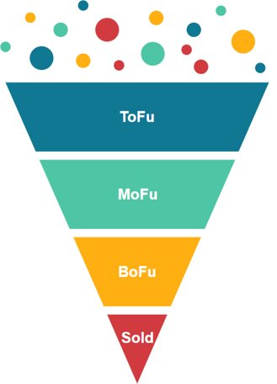
Email Automation
Define scenarios
Draft emails

